Slide 1

AI-Powered Web Platform for Dermatological Diagnosis
-By Team 6
An innovative web-based solution that combines the strengths of computer vision, artificial intelligence, and large language models (LLMs) to offer instant skin health assessments. Users can simply upload images of their skin issues, and within seconds, receive intelligent, data-driven feedback—ranging from possible conditions to recommended next steps.
This project has already been communicated to Springer Nature.

Slide 2
Members of Team 6
Sayan Maity University Roll No. 12021002029198
Pinaki Pritam Singha University Roll No. 12021002029065
Trideep Saha University Roll No. 12021002029040
Ratul Das University Roll No. 12021002029046
Kuntaleeka Kundu University Roll No. 12021002029016
Tathagata Ghosh University Roll No. 12021002029039
Suchak Sarkar University Roll No. 12021002029071
Yagnasree Chakraborty University Roll No. 12021002029062
Aniket Marik University Roll No. 12021002001073
Nilarghya Nandan University Roll No. 12021002029036

Slide 3
Literature Survey & Gap Analysis
ResNet and Inception architectures enhance performance on diverse skin conditions
LLMs like GPT and Bard enable natural-language explanations and contextual symptom analysis.
AI systems can provide customized skincare plans using image analysis and user profiling.
Passwordless authentication (e.g., Magic SDK) improves usability and security.
Freemium models and integrations like Razorpay help monetize health platforms.
Cloud-native architecture supports real-time AI inference and global scalability.
Most platforms focus on either diagnosis or NLP—not both in a real-time, accessible web app.
Few models provide clear, LLM-generated insights alongside disease classification.
Real-time AI diagnosis platforms with strong privacy and global access are limited.

Slide 4
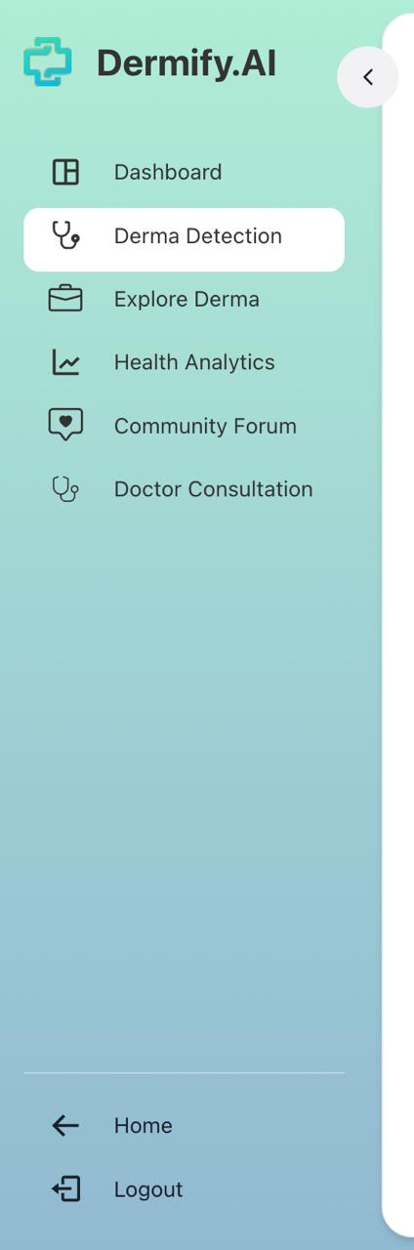
Product Features
1
Dashboard: for Regular Health Monitoring
2
Derma Detection: CNN + LLM based Module for Dermatological Diagnosis
3
Explore Derma: Module for Dermatological Education and Infographics
4
Health Analysis: Daily Survey for User Well-being
5
Community Forum: Real time connection across the globe
6
Doctor Consultation: Connect with an Actual Doctor for further Diagnosis

Slide 5
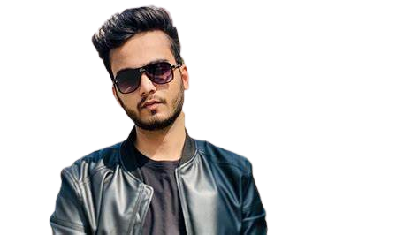
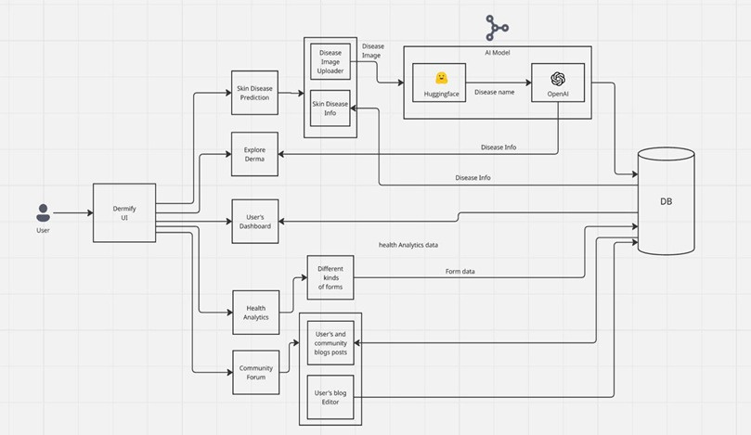
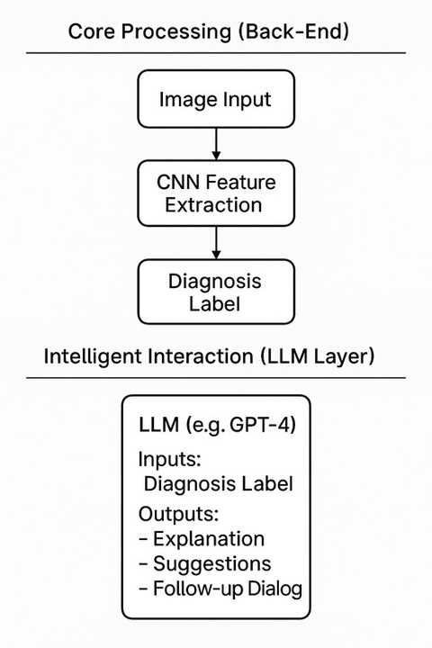
System Architecture

Slide 6
System Implementation
Programming Languages: Python, Javascript
Tools & Libraries:
OpenCV: For image processing.
TensorFlow/Keras: For machine learning models analysing skin diseases
MongoDB: Manages user data, including identities and exam details.
HTML, ChakraUI, ReactJs: For building the front-end interface (interface titled Dermify), HuggingFace, Vercel, and Render: For scalable cloud infrastructure supporting high concurrency. OpenAI: API for NLP capabilities only

Slide 7
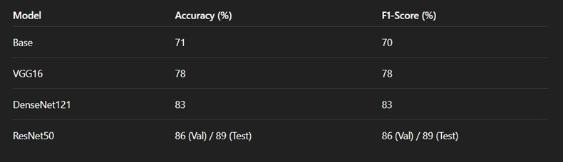
Model Training &
Comparative Analysis
We ran a comparative analysis on these four CNN Models:
The analysis reveals that transfer learning from ImageNet-pretrained models consistently enhances performance. Architectures like ResNet50 and DenseNet121, which incorporate advanced connectivity patterns (residual and dense connections respectively), significantly outperform traditional deep networks like VGG16, especially in domains requiring nuanced feature recognition such as skin lesion classification.
The ResNet50 model was selected for skin disease classification. The final trained weights and configuration were prepared for deployment on the Hugging Face Model Hub. The trained model was serialized using the PyTorch framework, by saving the entire model object using the torch.save() method.

Slide 8
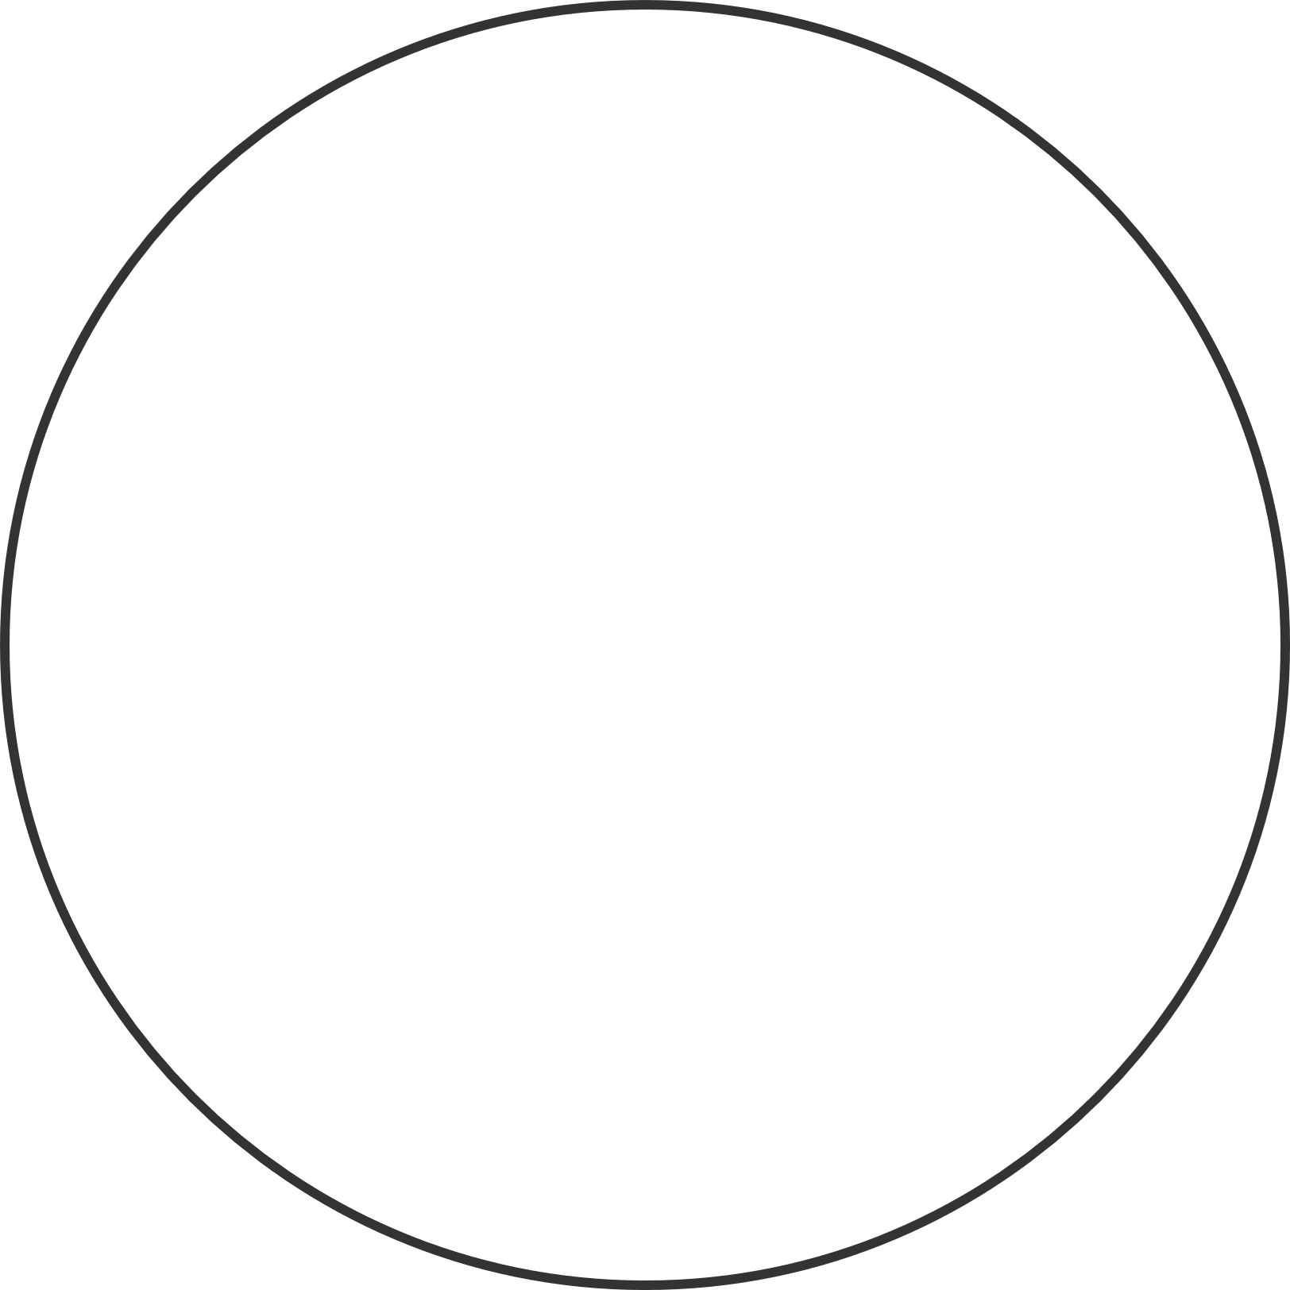
Web Deployment
The backend was developed using FastAPI, a high-performance asynchronous framework. Node.js is used for managing real-time communication and frontend integration, while MongoDB serves as the primary database for storing and retrieving user data and inference results.
The frontend was built using React, a flexible JavaScript library for building dynamic user interfaces. Chakra UI was used to design an accessible and responsive component-based layout, ensuring a seamless user experience. The application is deployed on Vercel, enabling fast, serverless deployment with continuous integration and delivery.

Slide 9
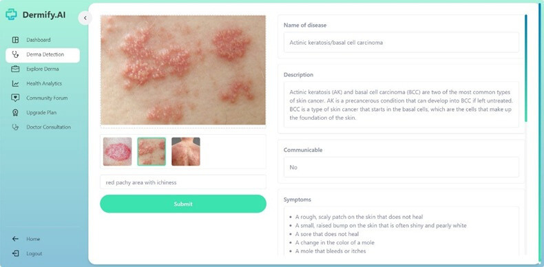
LLM Application
OpenAI has provided us with an endpoint for its gpt-4o-mini model. This endpoint is powering our diagnosis prediction by providing us with relevant and most recent details about the predicted disease. The LLM implemention here is used solely for its NLP, Search and Chat capabilities.

Slide 10
Limitation & Features
The LLM simplifies medical language but lacks clinical judgment.
Outputs may be misinterpreted as medical advice despite disclaimers.
Operates probabilistically for coherence, not clinical accuracy.
Requires stable internet and external API service availability.
Service disruptions or regional access limits can affect system performance.
High computational demands for deep learning and real-time LLM interactions.

Slide 11
Future Scope
Use adaptive image processing and larger, more diverse datasets.
Enhance performance across various skin tones, lesion types, and lighting conditions.
Mitigate bias and increase global applicability.
Introduce context-aware chat support and intelligent follow-up queries.
Deliver more personalized and guided user experiences.
Add features for tracking skin condition changes over time.
Suggest proactive lifestyle changes and integrate wearable devices.
Implement localized data processing and stricter deletion protocols.
Introduction for premium plans with payment gateway for actual doctor consultation.

Slide 12
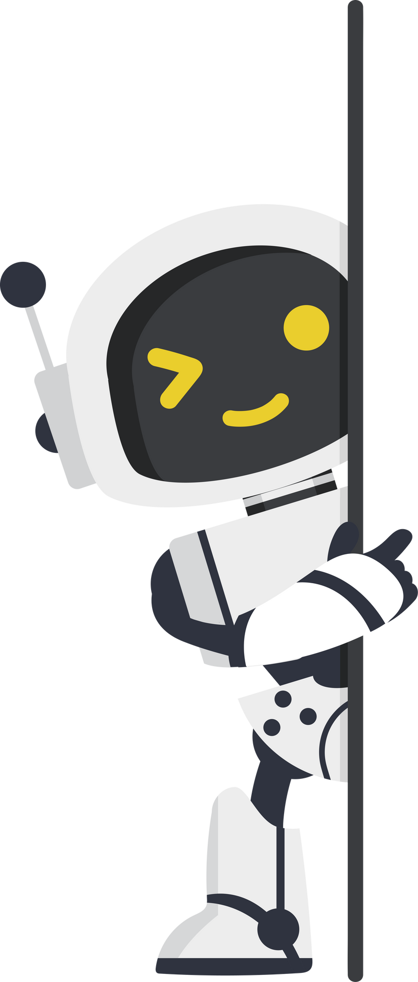
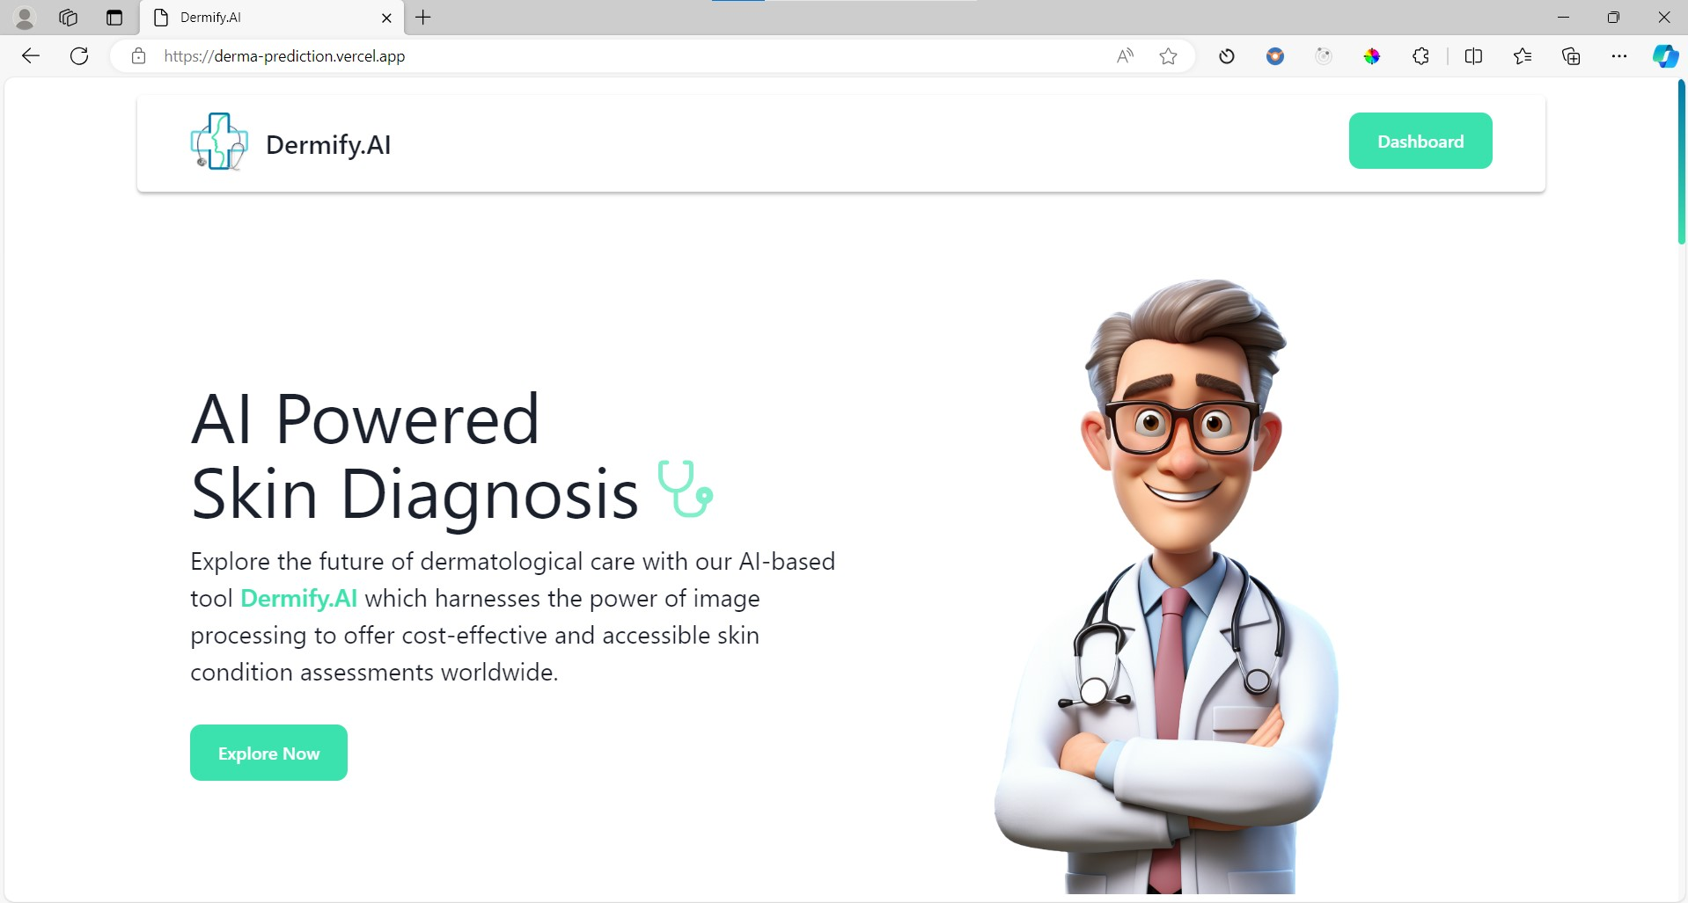
Thank You

